Slide 1
Taking Ownership, Building Platforms
Reterritorialising Social Media
FIRE: Forum for Indigenous Research Excellence
University of Wollongong
November 2015
Leesa Watego
@IscariotMedia and @DeadlyBloggers

Slide 2
Next September it will be a decade since Facebook became available to the general public. Since that time, Indigenous Australians and Indigenous Peoples worldwide have used Facebook to connect, express, and mobilise. The ready access that an email address gave, the easy and consistent interface, and the sometimes persistent pressure of one’s peers meant that most of us have willingly given ourselves over. For most, Facebook IS the internet. For a few others however, blogging becomes a goal once they realise the gated community has limitations. This paper will raise questions about how we provide support to those wishing to expand their communication opportunities, and to begin to create their own owned spaces.

Slide 3





Slide 4
Current writings by Aboriginal and Torres Strait Islander people belong within a cultural and historical continuity that predates the invasion whilst utilising, adapting and challenging the written genres and forms of the colonising culture.
Anita Heiss

Slide 5
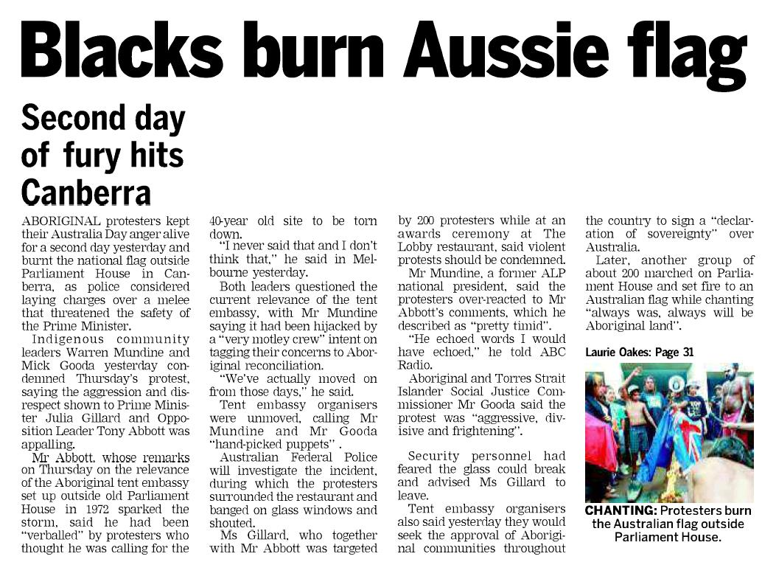
Representation of Indigenous People in the Media
Representations of Aboriginal people are informed by the media.
“Theatre of pathology” Fiona Nicholls
“We have been portrayed … as negligent and abusive parents, extremely violent, sexually abusive, corrupt, alcoholic, substance abusers and bludgers on welfare, suffering from cultural disfunction …”
Aileen Moreton-Robinson, 2012
http://caudallure.wordpress.com/2012/01/30/racist-headline-in-tasmanian-newspaper/

Slide 6

About Deadly Bloggers
History -
Began as a “blogroll” on a personal blog
A hashtag on Twitter
A blog of its own on Blogger
A Twitter profile
A Facebook page
A G+ Page
A self-hosted Wordpress site
Website www.deadlybloggers.com
Twitter www.twitter.com/deadlybloggers
Facebook www.facebook.com/deadlybloggers

Slide 7
This presentation - a research tool (survey)
Responses -
Only a small percentage of Aboriginal & Torres Strait Islander people
Platforms - Blogger, Wordpress, Tumblr. Majority do not have self-hosted spaces
Small percentage have more than one blog
All self-taught. A few have attended workshops.
Feminism, Fashion, Design, Lifestyle, Politics, Education, Indigenous Organisations, Language, Culture, Health, Well-being, Professional, Writers, Literature, Business, Arts,

Slide 8
Why do you blog?
Responses -
Expression - share my stories, my life, my ideas, my travels,
Strategic - build a professional profile
Activism - blogging is about Freedom + Empowerment - “no one can stop me”,
Professional - income generation
Image: by Tammy Law. Header on Anita Heiss blog.

Slide 9
Impact of blogging
Responses -
Professional success
  launch of an online magazine
  professional writing gigs (msm), increased credibility, speaking engagements
  publishing contracts
Skills development
  improve writing skills
  better engagement
  deeper connections
National culture
  Archived in Pandora (National Library)
Personal
  Feels good to have a place to “speak in my own voice”
Blonde Ink www.blondeink.net
Big Ink http://blondeink.net/category/the-big-ink/
Images - Screen shots

Slide 10
Racism and other forms of discrimination
Have you experienced racism as a result of blogging?
Do you self-censor your posts to limit racist responses?
Responses -
Of respondents, only a small percentage indicated they had experienced racism as a result of their blogging.
Usually in the comments section.
Most indicated they would not be hesitant about writing something because of the likelihood of racist attack.
A few indicated that they have deleted tweets after making them.
“some non-Indigenous people Storify tweets out of context”

Slide 11
Advice to others concerned about racism -
Responses -
Take the good with the bad (like all of life)
Use a pseudonym if you’re concerned
Take time to post (sleep on it, edit again, before you publish)
There will always be haters, be courageous
Don’t take it personally
Know the risks before you start. Think about privacy before you start
Build a supportive network
Do not read the comments

Slide 12
Your Blogging Goals
Responses -
Build an app and other products
Build a more professional blog
Earn a living
Generate more msm writing opportunities
Generate online products - films, screenwriting, books
Build a regular readership

Slide 13
Biggest hurdles for Murris in the blogosphere
Responses -
Technology
Access
Racism - from commenters, lateral violence
Promotion
Time!!!
Pigeonholed into “an Indigenous blogger” category

Slide 14
General comments
Because of blogging ...
I feel less alone
I’ve found my voice
I’ve found new direction, career
I’ve made new friends and partnerships
Blogging ...
takes too much time
is great, but the Australian media & trolls make it very tough for Indigenous voices
=> Write what you love, don’t think of the $ yet

Slide 15
What is re-territorialisation?

Slide 16
Conceptualisations of social media
Social Media as Personal Communication
Social Media as Activist Space
Social Media as trade route
Social Media as critical expression

Slide 17
Building Legacy
> Archivable, findable
> Is social media a midden?
What resources (people, financial, intellectual) are needed to create such a legacy?

Slide 18
Blogging, & other forms of online publication, allow writers to define themselves (and their Aboriginality). It can provide a space where we can play, explore, create, debate, rant and vent, satirise, and philosophise the world in which we live.
Online publication, like other forms of publication, are defined by particular structures. Issues of access, ownership, permanence, and security all impact on the effectiveness of online publication for us. But the potential to throw down or bypass the gatekeepers of traditional publication is too great to ignore.

Slide 19
@LeesaWatego
@DeadlyBloggers
@IscariotMedia
@DarkDisturb
@CriticalClassrm

